Slide 1


RV College of
Engineering
Department of Artificial Intelligence and Machine Learning
DESIGN THINKING LAB
AI237DL
Team Members
Name of the Student USN
1.ADITYA RANJAN 1RV23AI008
2.GARV AGARWALLA 1RV23AI034
3.AHIBHRUTH A 1RV23AI011
4.DIPTANSHU KUMAR 1RV23AI033
Domain
Digital Humanities
Mentor
Dr. Vijayalakshmi M.N
Associate Professor
Department of AI&ML ,RVCE
Department of Artificial Intelligence and Machine Learning
Notes:
<number>

Slide 2
AGENDA
RV College of
Engineering
INTRODUCTION
EMPATHY PHASE
DEFINE PHASE
IDEATION PHASE
PROTOTYPE PHASE
CONCULSION
Department of Artificial Intelligence and Machine Learning
Notes:
<number>

Slide 3
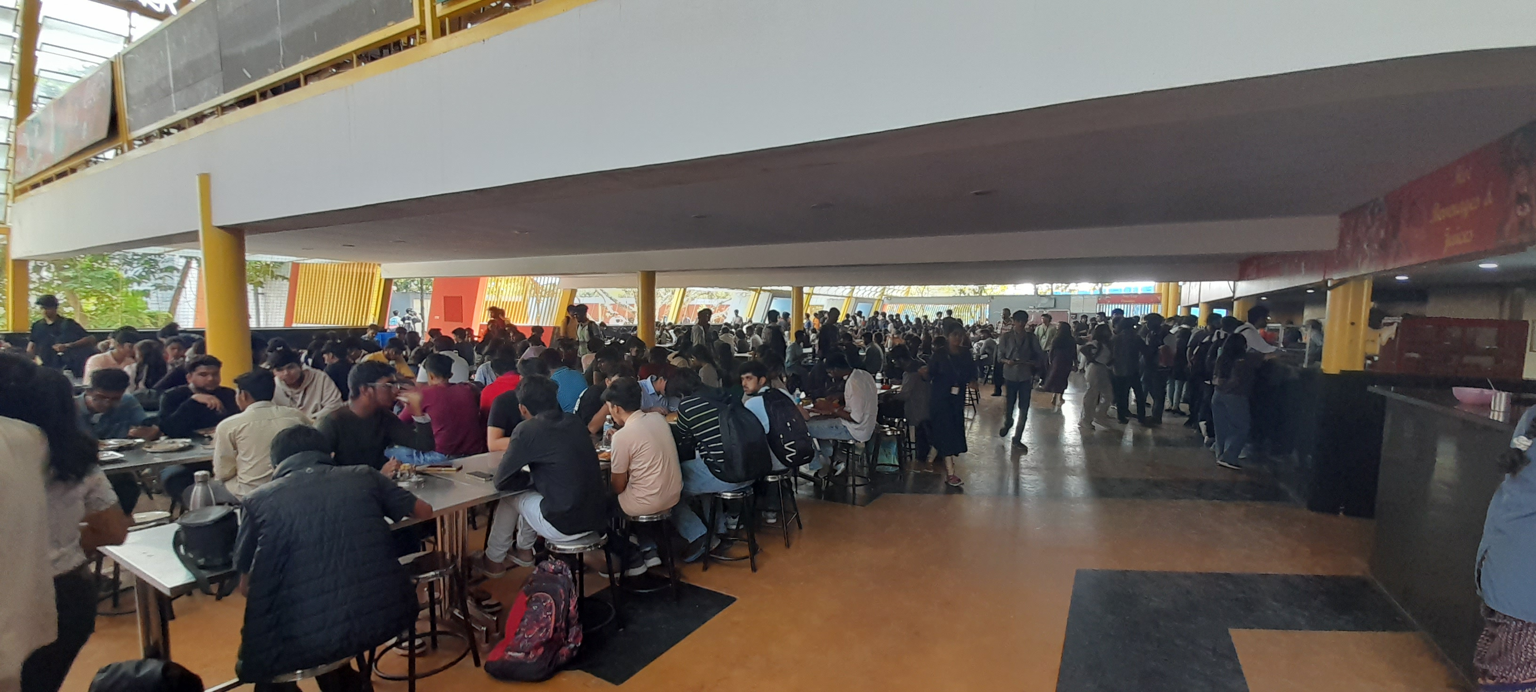
INTRODUCTION
Mingos, the college dining facility, faces challenges during peak lunch hours with long wait times, overcrowding, and inefficient service. These issues lead to dissatisfaction among students and faculty, impacting schedules and reducing meal accessibility. Implementing a pre-booking system could enhance service efficiency, streamline queues, and improve the overall dining experience.
Department of Artificial Intelligence and Machine Learning

Slide 4
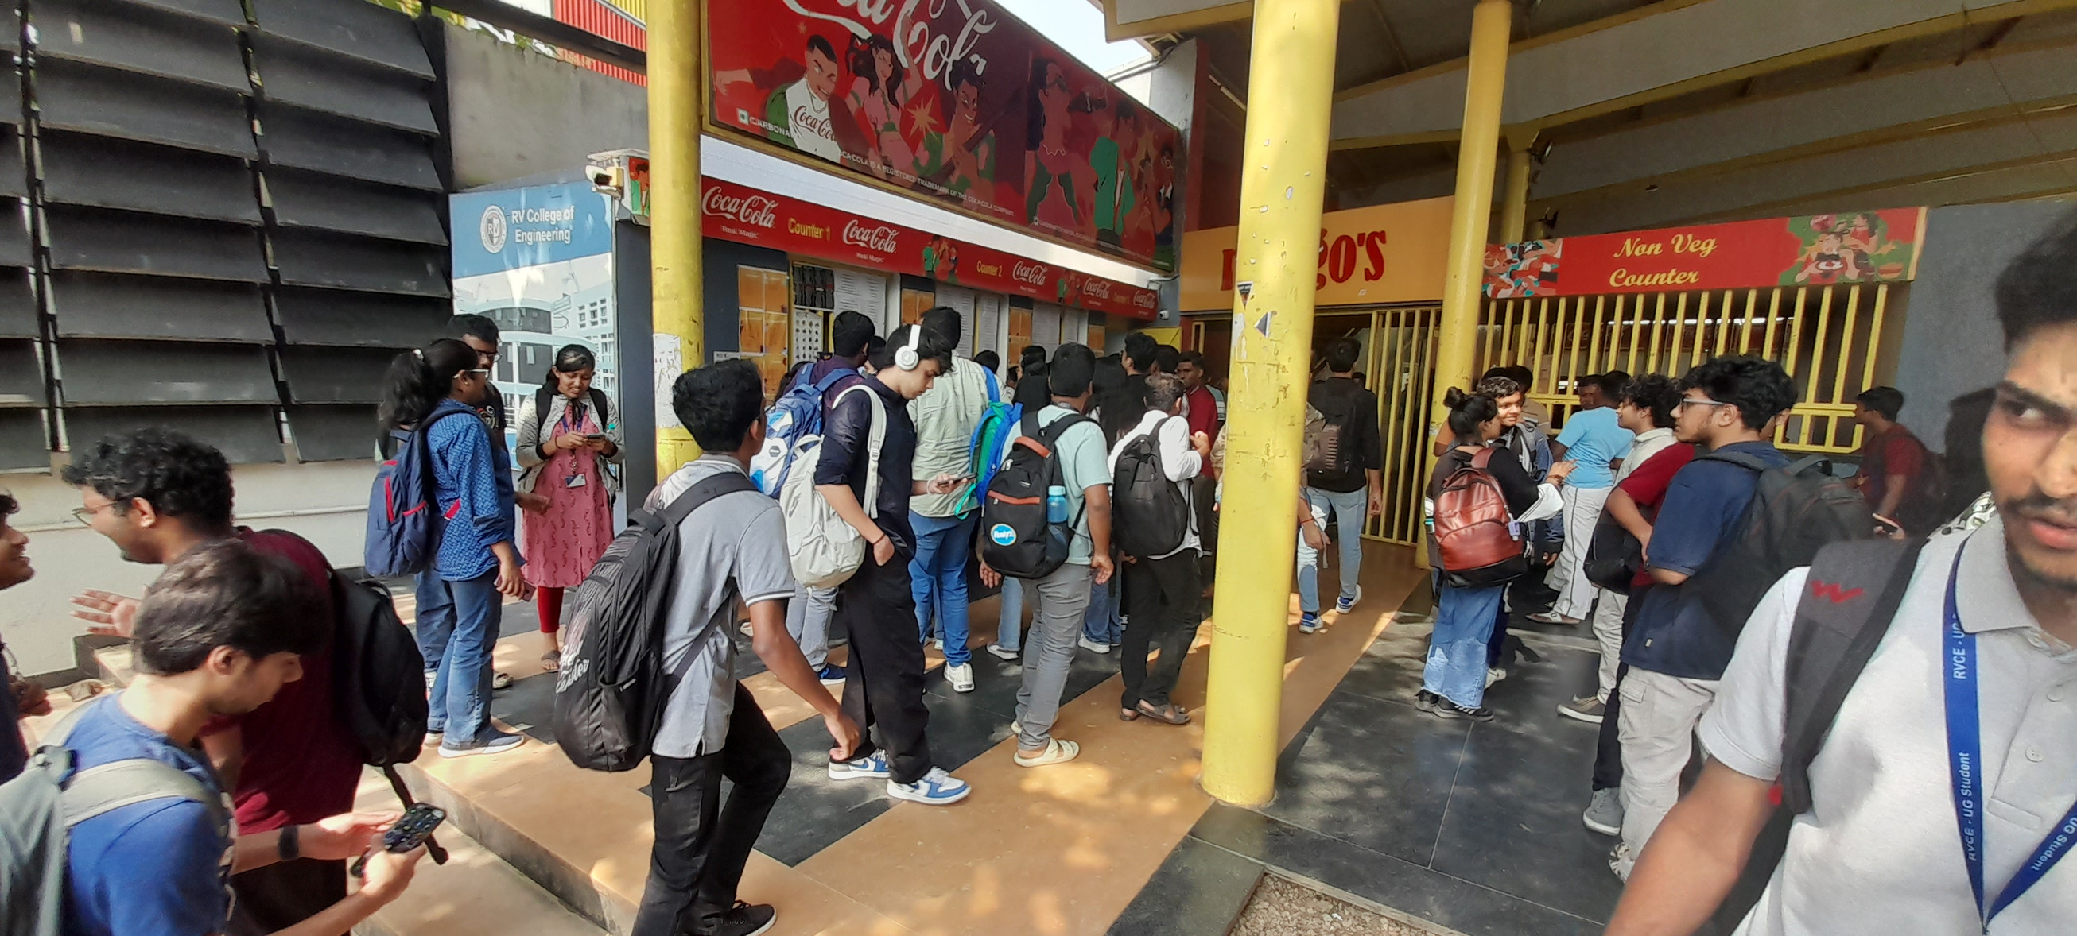
MOTIVATION
Long Wait Times
Overcrowding
Missed Meals
Inefficient Queue Management
Staff Workload Pressure
Need for a Streamlined Solution
Department of Artificial Intelligence and Machine Learning

Slide 5
EMPATHY
EMPATHY
Tools for Phase:
Empathy Maps:
- Help developers and designers understand user needs, emotions, and behaviors.
- Visualize user perspectives by categorizing what they say, think, feel, and do.
- Identify user pain points, such as long wait times and confusion about procedures.
- Facilitate the design of a user-centric queue management system.
STP Analysis (Segmentation, Targeting, Positioning):
-Segmentation: Identify distinct user groups with unique requirements.
-Targeting: Select the most valuable segments to address, aligning system features with their needs.
-Positioning: Craft a clear message that highlights how the system meets user needs better than competitors.
Department of Artificial Intelligence and Machine Learning

Slide 6
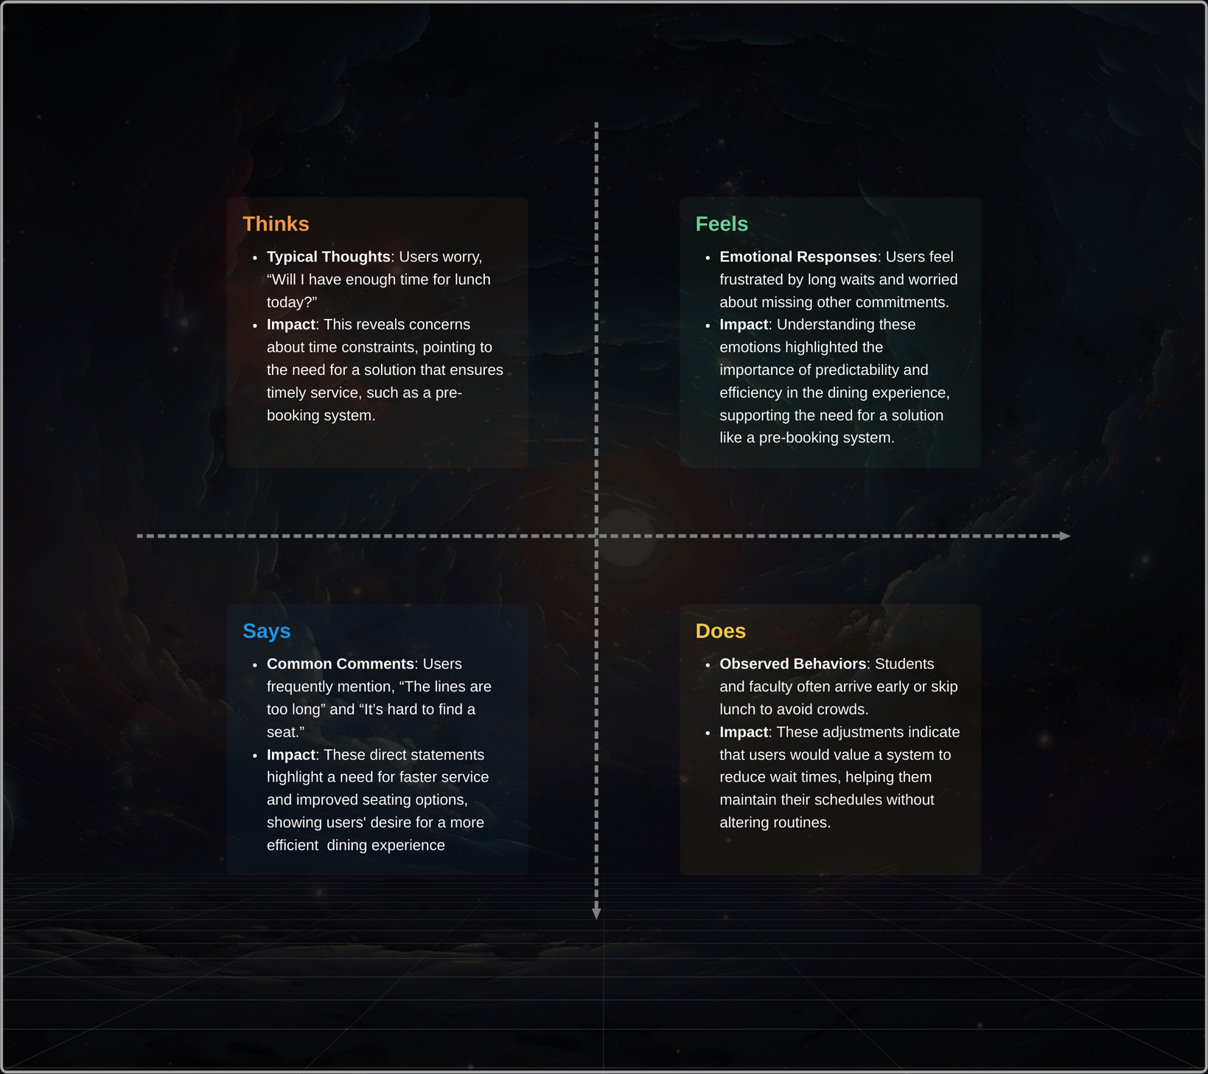
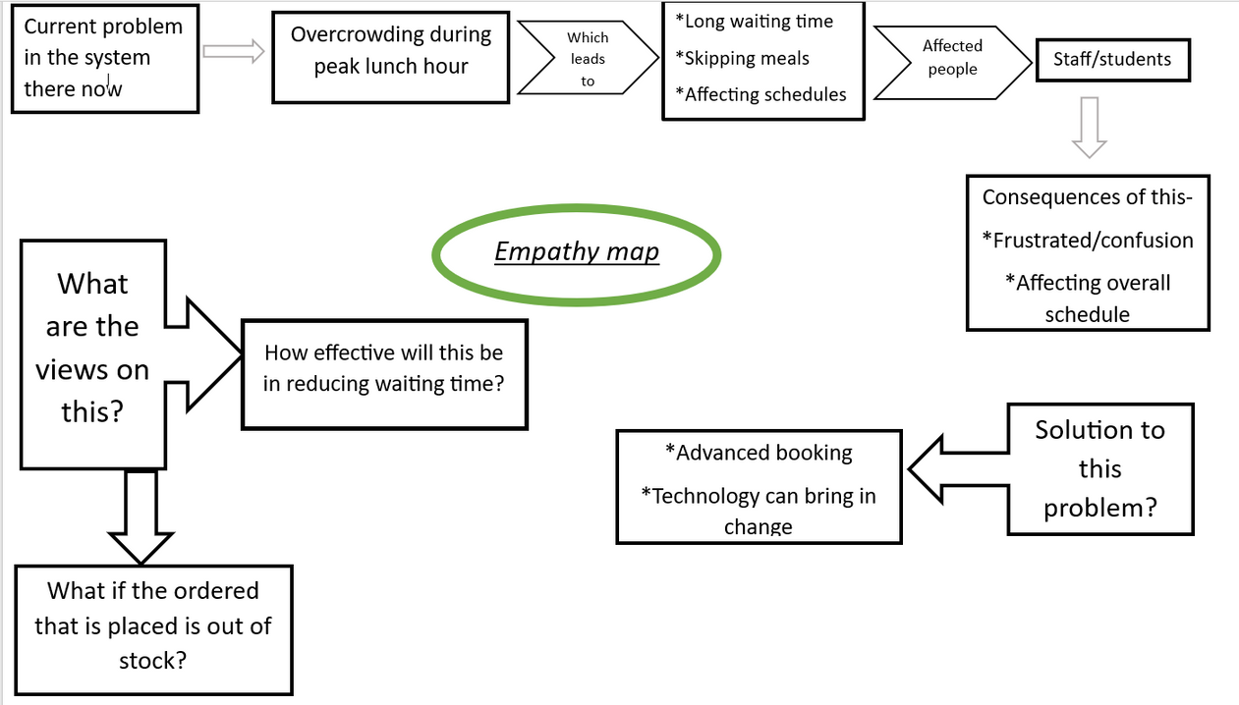
EMPATHY
EMPATHY
ANALYSIS
Department of Artificial Intelligence and Machine Learning

Slide 7



EMPATHY
STP ANALYSIS
Segmentation
S
Students who wait during lunch break
Faculty members find time to eat during between classes
Targeting
T
Primary targets-Students
Secondary targets-Faculty members
Positioning
P
Positioning the advanced booking as a quick,reliable to streamline the dining experience and to provide hassle free lunch hour
Department of Artificial Intelligence and Machine Learning

Slide 8
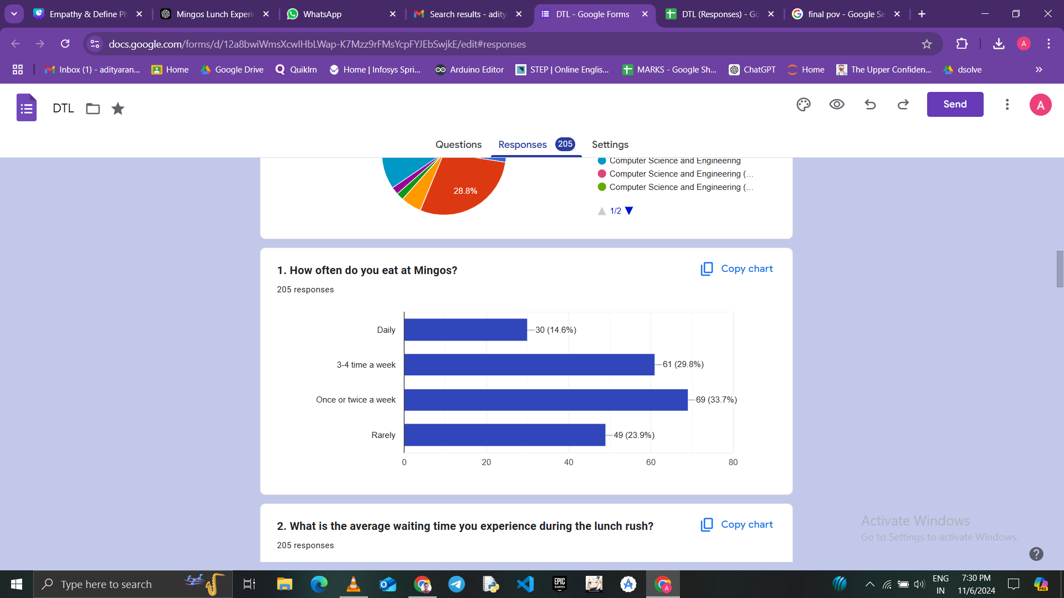
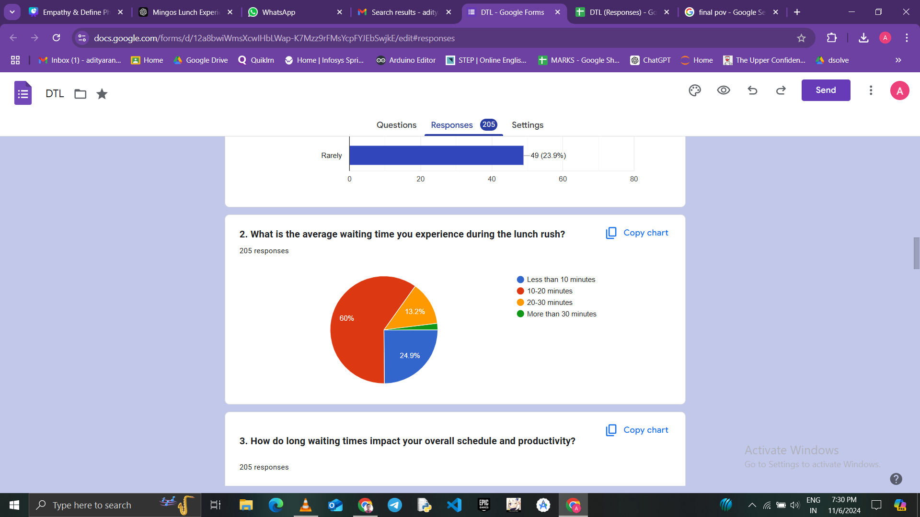
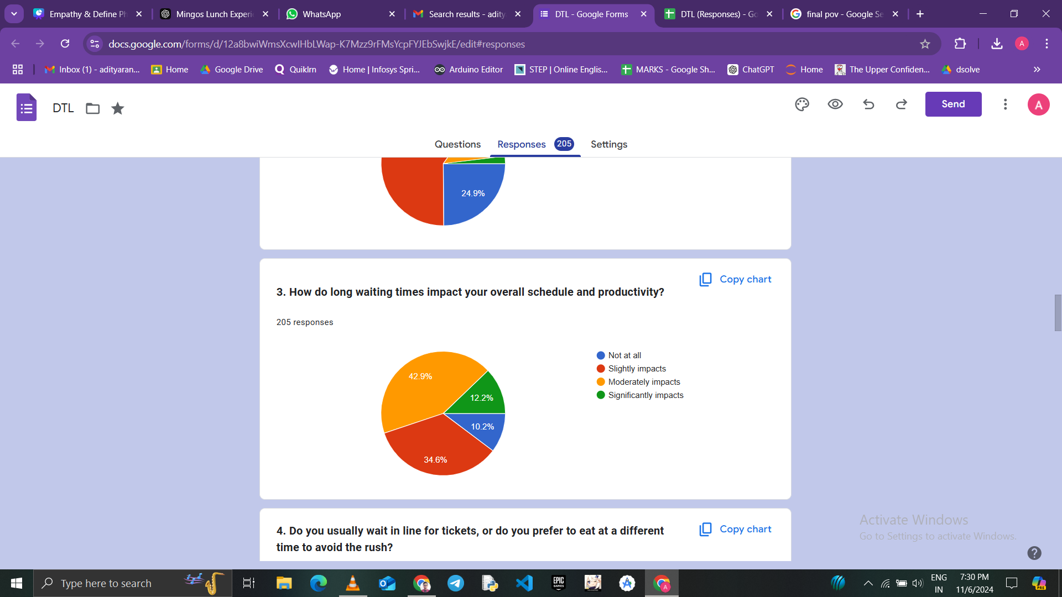
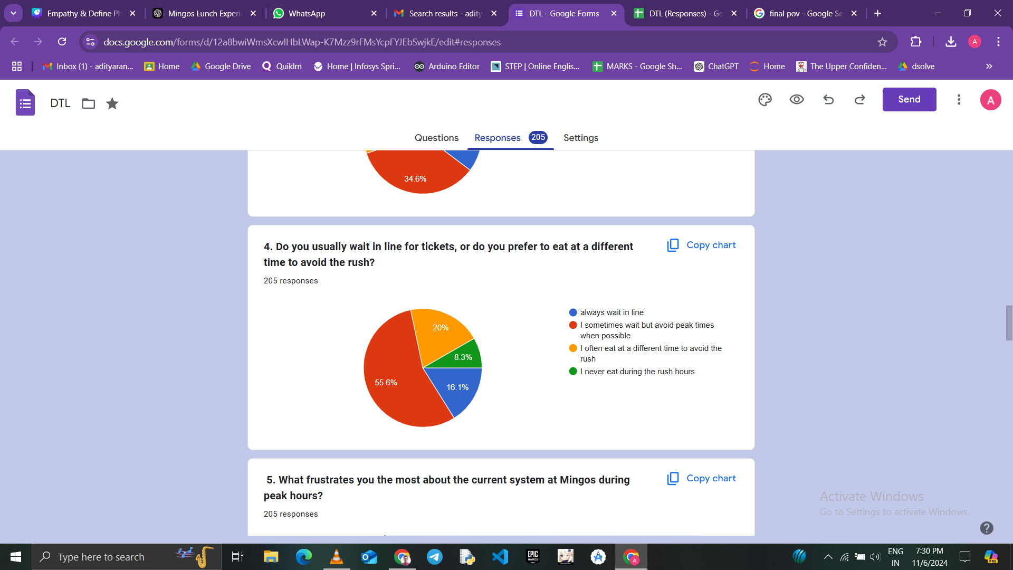
EMPATHY
Department of Artificial Intelligence and Machine Learning

Slide 9
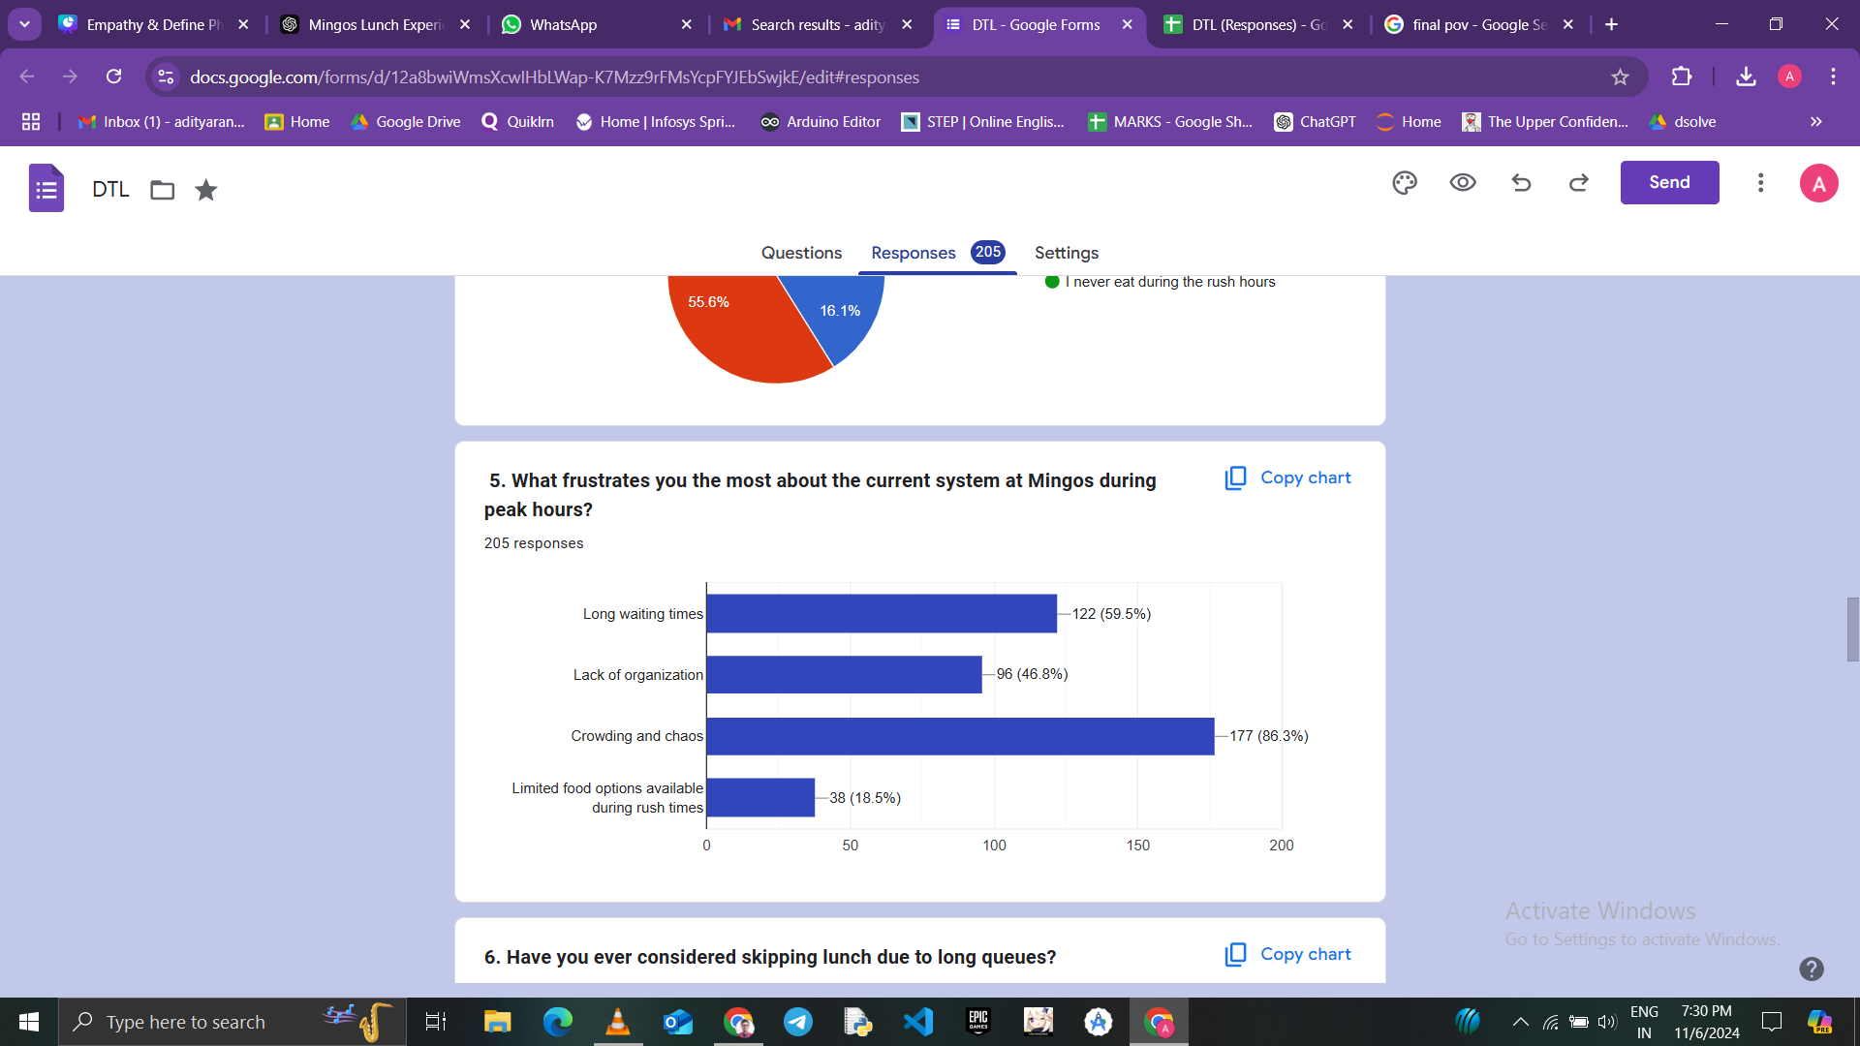
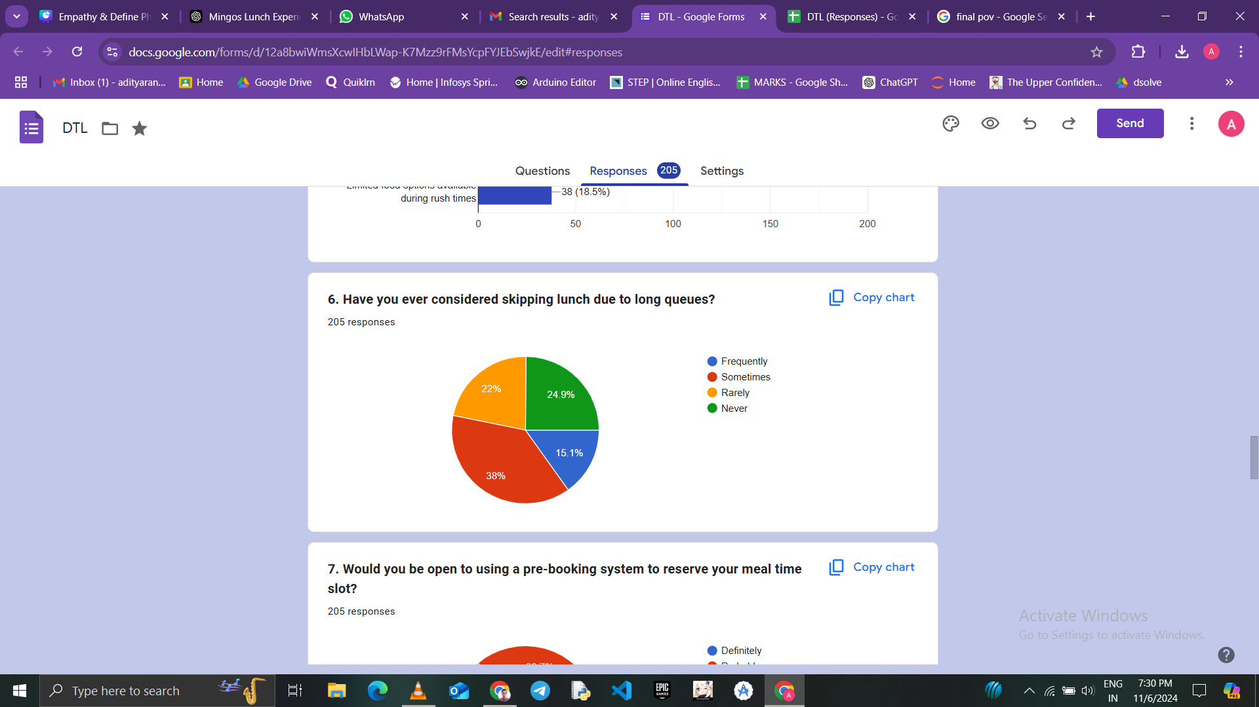
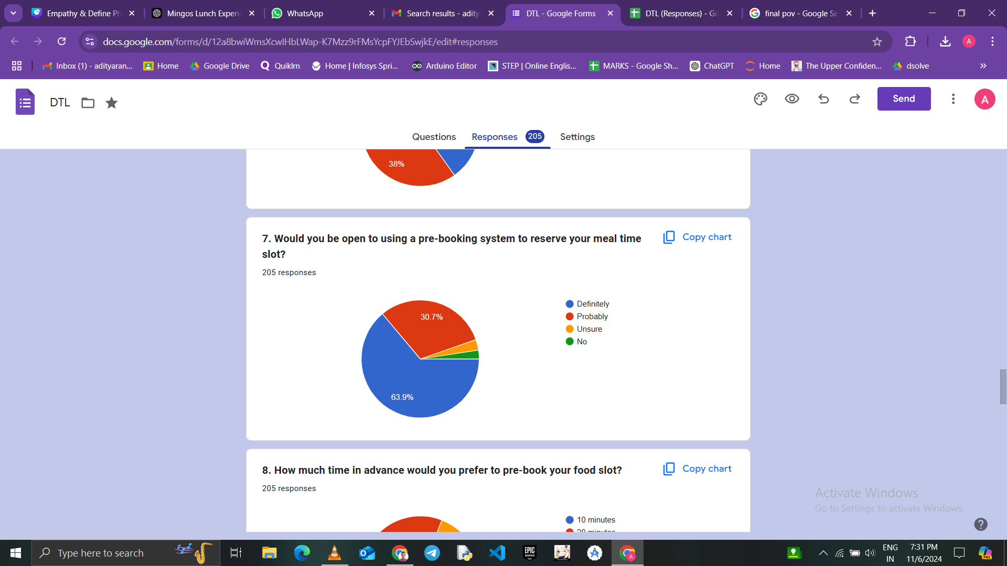
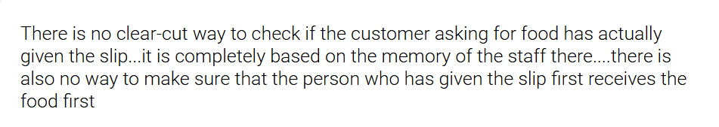
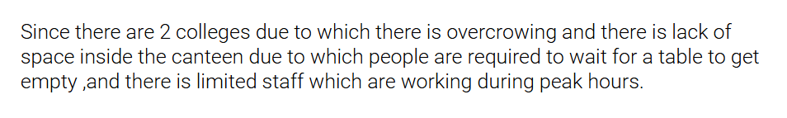
EMPATHY
Department of Artificial Intelligence and Machine Learning

Slide 10
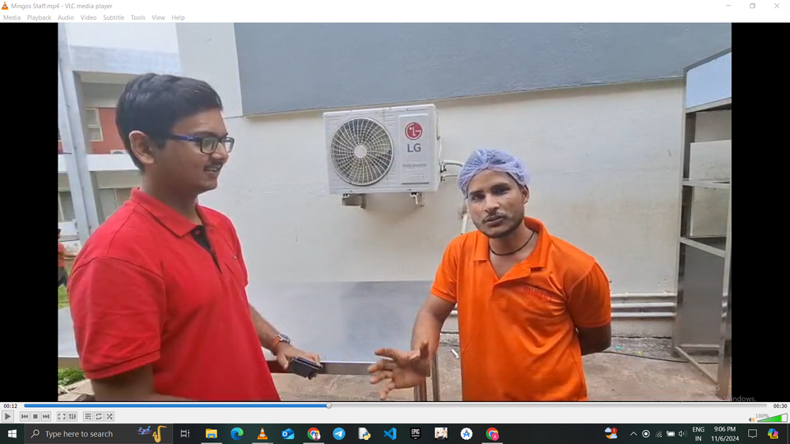
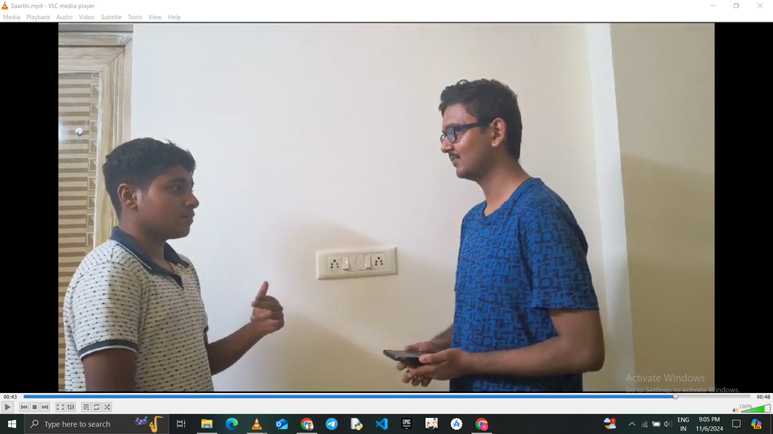
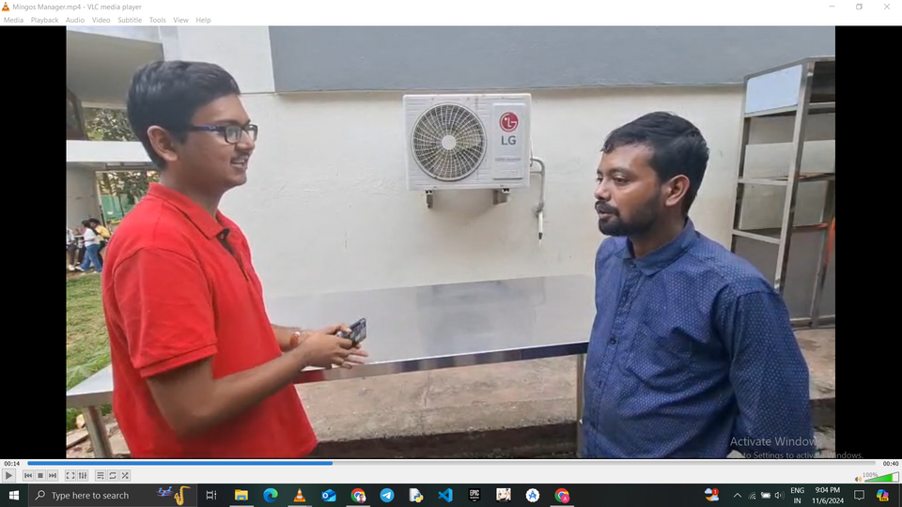
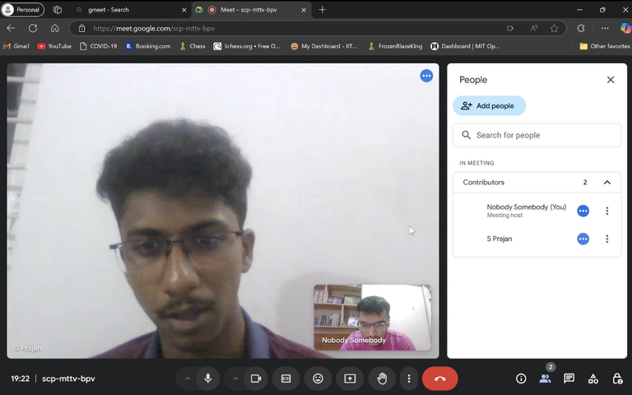
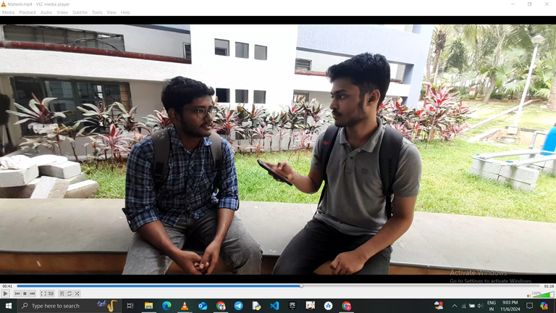
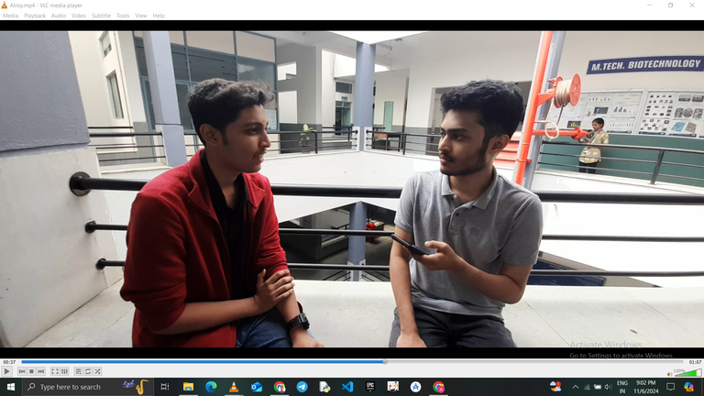
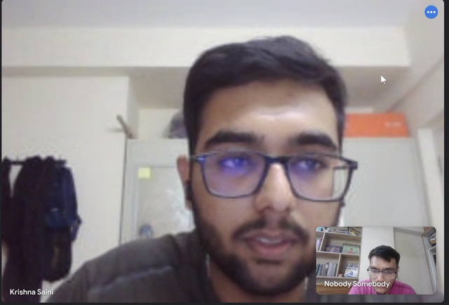
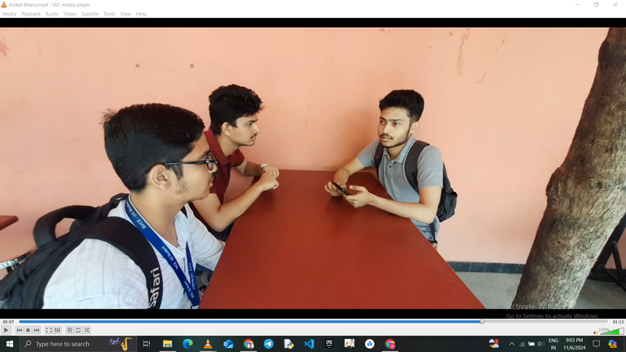
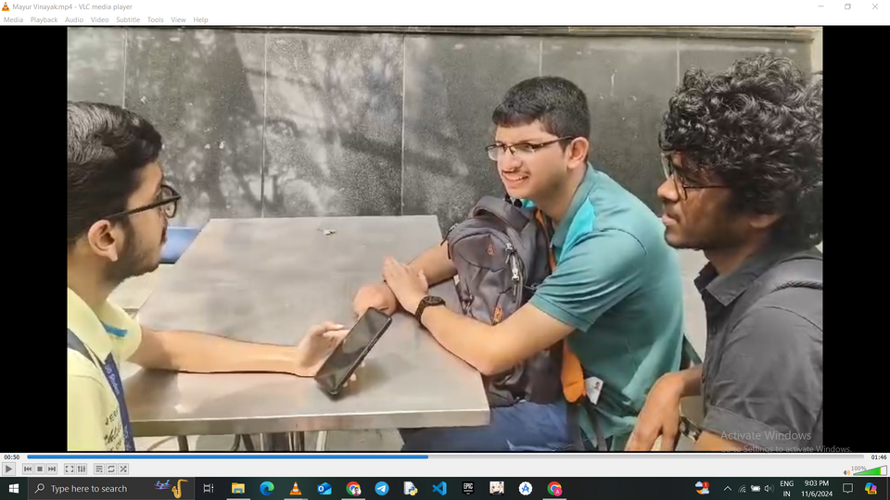
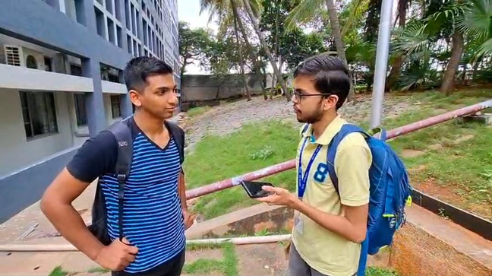


EMPATHY
Department of Artificial Intelligence and Machine Learning

Slide 11
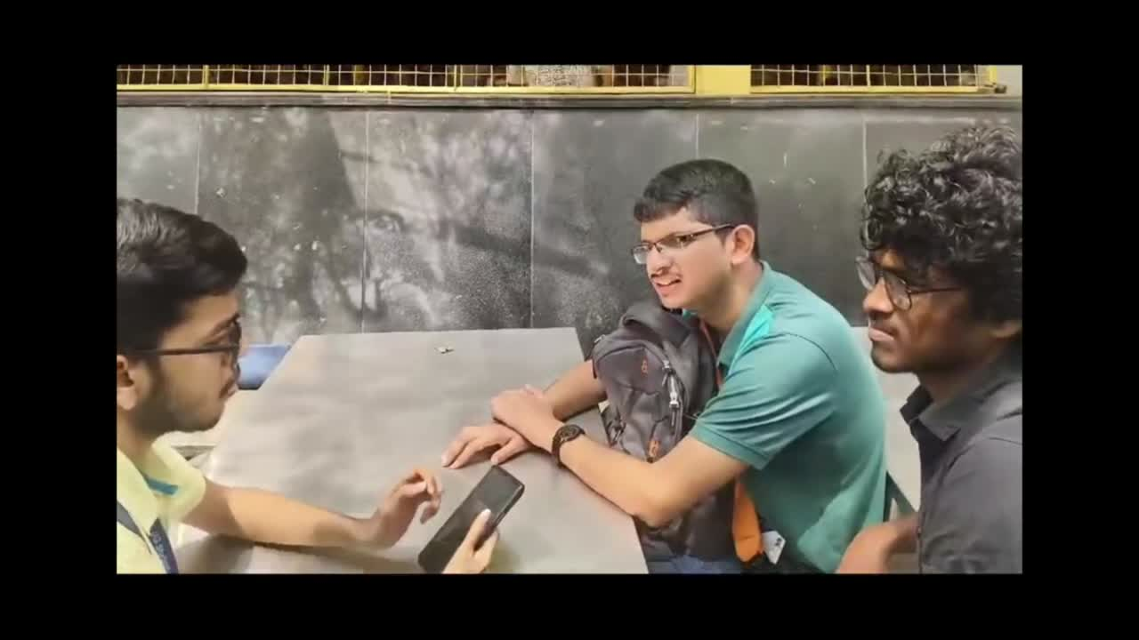
EMPATHY
SURVEY INTERVIEW
Department of Artificial Intelligence and Machine Learning

Slide 12
DEFINE
DEFINE
Tools for Phase:
SWOT Analysis :
-SWOT analysis is a strategic planning tool that evaluates an organization or project’s *Strengths*, -*Weaknesses*, *Opportunities*, and *Threats*. It helps identify internal and external factors that affect objectives, guiding decision-making and strategic development.
Stakeholder Mapping :
-Stakeholder mapping analysis identifies and categorizes stakeholders based on their influence, interest, and impact on a project. This helps prioritize engagement efforts, ensuring effective communication and collaboration with key players to meet project objectives and address stakeholder needs efficiently.
Department of Artificial Intelligence and Machine Learning

Slide 13


DEFINE
SWOT
ANALYSIS
S
STRENGTHS
W
WEAKNESSES
A pre-booking system can reduce wait times and improve service flow.
Implementing the system may require upfront investment and training.
O
OPPORTUNITIES
T
THREATS
Enhances student and faculty satisfaction, potentially increasing facility usage.
Risks include potential technical issues and reliance on user adoption.
Department of Artificial Intelligence and Machine Learning

Slide 14
DEFINE
Primary Stackholder
Students and faculty are the primary users of mingos, directly affected by long wait times and overcrowding. Enhancing better time management will benefit them during their busy schedules.
Secondary Stackholder
Canteen staff and food suppliers are essential to maintaining service quality and meeting demand and a streamlined system would reduce workload, boost efficiency, and improve coordination.
Food Suppliers
Students
Parents
Stake-Holder
Mapping
Primary
Secondary
Faculty
Mingos Staff
Department of Artificial Intelligence and Machine Learning

Slide 15
DEFINE
How might we ensure that students and staff can easily find available food options in real time?
How might we design a system that notifies customers if their chosen food item becomes unavailable after pre-payment?
How might we manage and reduce crowding by implementing better queue management and pre-booked time slots?
How might we make the pre-booking process simple and accessible for students during classes or limited breaks?
How might we improve the experience of collecting food to avoid confusion and long wait times?
Department of Artificial Intelligence and Machine Learning

Slide 16
DEFINE
Madlib
Our users are Students who need a way to reduce wait times and improve the dining experience during peak hours because of limited time and overcrowding.
Department of Artificial Intelligence and Machine Learning

Slide 17
DEFINE
Final PoV
Students want a queue-management and real-time update system at Mingos to reduce wait times, streamline pick-up, and improve their overall dining experience, making lunch hours more efficient and satisfying.
Department of Artificial Intelligence and Machine Learning

Slide 18
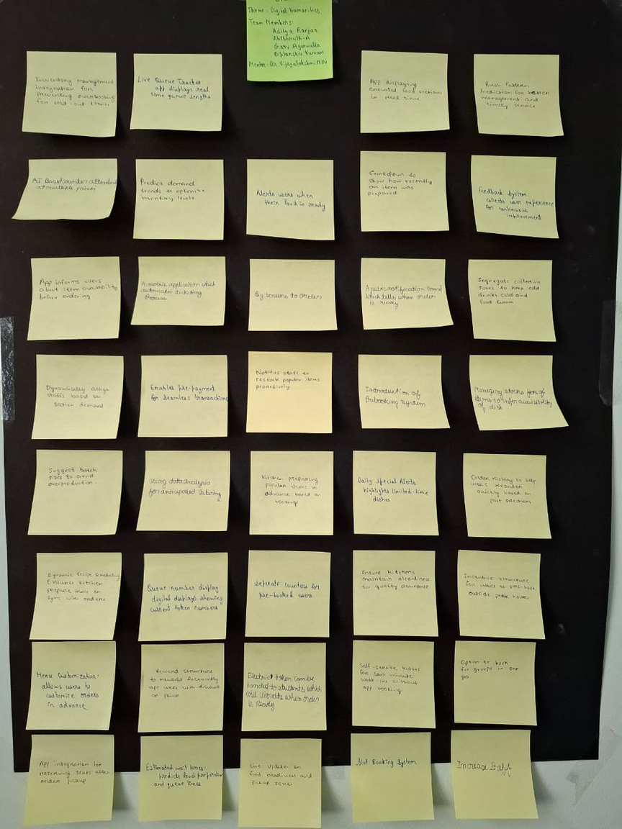
IDEATION
Ideas generated by the team:
1.Slot booking system:Users can select time slots to reduce waiting times
2.Estimated wait times:Predicts food preparation and queue times
3.Token based entry system:QR codes for access to service points based on booking time
4.Notifies staff to restock popular items proactively
5.Daily special alerts:highlights limited time dishes.
6.Rush pattern-prediction for better management and timely service.
7.Enables pre-payment for seamless transactions
8.Menu customization
9.Countdown to show how recently an item was prepared
10.Managing stocks of items to infer availability of dishes.
11.Dynamic recipe scheduling -ensure kitchen prepare items in sync with orders
12.App informs users about availability before ordering.
Department of Artificial Intelligence and Machine Learning

Slide 19
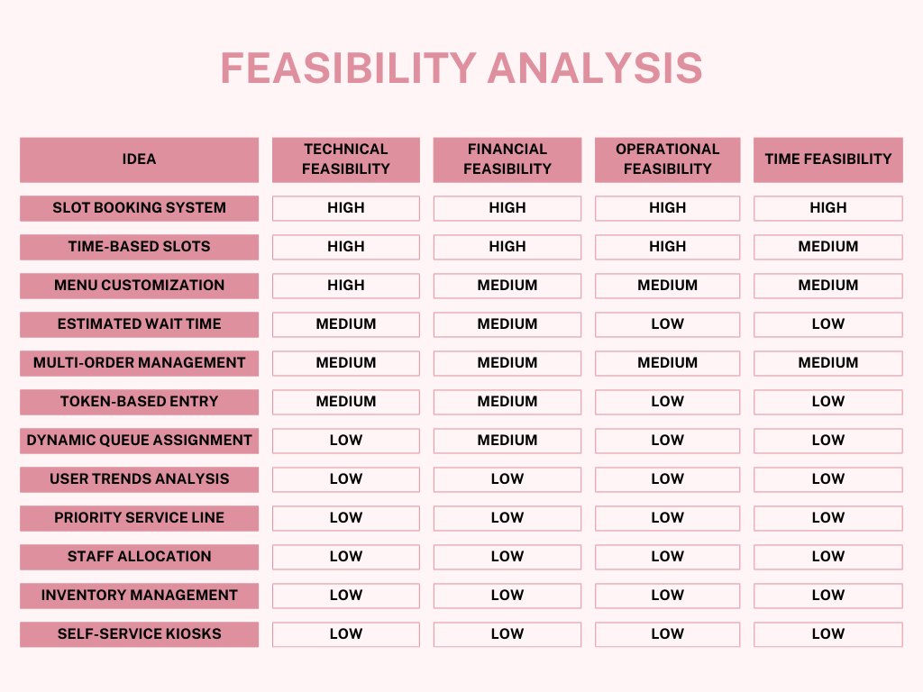
IDEATION
Technical Feasibility: Can it be implemented with the technology and skills we have ?
Financial Feasibility: Does it fit within a student budget ?
Operational Feasibility: Can we implement it without interfering with live systems ?
Time Feasibility: Can it be completed within a reasonable timeframe ?
Most Feasible Ideas:
Slot Booking System
Time-Based Slots
‹#›
Department of AI & ML
Department of Artificial Intelligence and Machine Learning

Slide 20

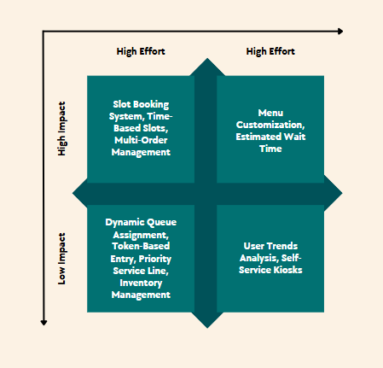
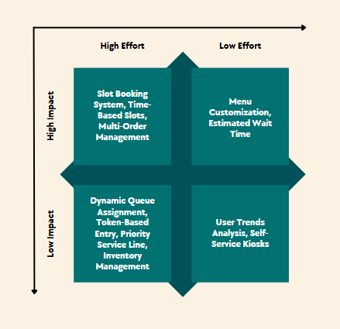
IDEATION
MoSCoW Prioritization
Must-Have
Slot Booking System
Time-Based Slots
Should-Have
3. Menu Customization
4. Estimated Wait Time
Could-Have
5. Multi-Order Management
6. Token-Based Entry
Won’t-Have
7. Dynamic Queue Assignment
8. User Trends Analysis
9. Priority Service Line
10. Staff Allocation
11. Inventory Management
12. Self-Service Kiosks
Final Idea :
An app that enables students to pre-book time slots and customize food orders at Mingos ensuring a streamlined dining experience and reduced waiting times.
‹#›
Department of AI & ML
Department of Artificial Intelligence and Machine Learning

Slide 21
PROTOTYPE
Final Idea :
"A platform that lets students plan their meals in advance, combining technology with a focus on user-friendly design. It helps make the dining experience better by using technology for convenience."
"Order Easy, Eat Happily – Our College Canteen, Just a Telegram Away!"
Department of Artificial Intelligence and Machine Learning

Slide 22
PROTOTYPE
Web App/Cloud-Based Service
The bot operates over the internet and is accessible to users through the Telegram platform.
It doesn't require installation as it leverages Telegram's existing infrastructure.
Cross-Platform Application
Since the bot operates within Telegram, it is inherently cross-platform, working seamlessly on iOS, Android, desktop, and web versions of Telegram.
Automation Tool
Automates tasks such as order tracking, time-slot scheduling, and checkout management, improving user efficiency and convenience.
Click-Through Prototype
Department of Artificial Intelligence and Machine Learning

Slide 23
PROTOTYPE
Techniques used in Telegram Bot Implementation:
Telegram Bot Integration: Built using python-telegram-bot with various commands like /start, /menu, /counter, etc.
Loading Menu Data: Menu items and prices are loaded dynamically from a CSV file.
Time Slot Generation: Time slots are created using the datetime library, showing 15 min interval.
Basket Management: It stores the selected items and quantities using dictionary and dynamically calculates total price.
Department of Artificial Intelligence and Machine Learning

Slide 24
PROTOTYPE
Why Telegram:
Ease of Use: Telegram bots are accessible through the Telegram app, which is widely used and free.
Interactive Interface: Inline keyboards and messages allow for intuitive user interaction without the need for a dedicated mobile or web app.
Quick Setup: Telegram provides a simple API and infrastructure, eliminating the need to build a custom frontend or backend for basic features.
Real-Time Interaction: Telegram's platform supports instant communication and updates.
Scalability: Telegram bots can handle a large number of users simultaneously with minimal infrastructure requirements.
Department of Artificial Intelligence and Machine Learning

Slide 25
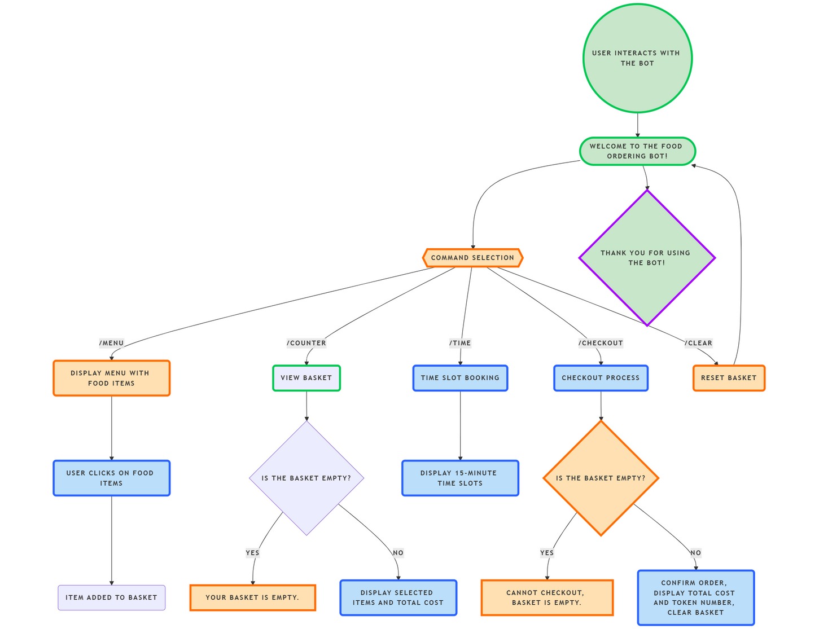
PROTOTYPE
Work Flowchart:
Department of Artificial Intelligence and Machine Learning

Slide 26
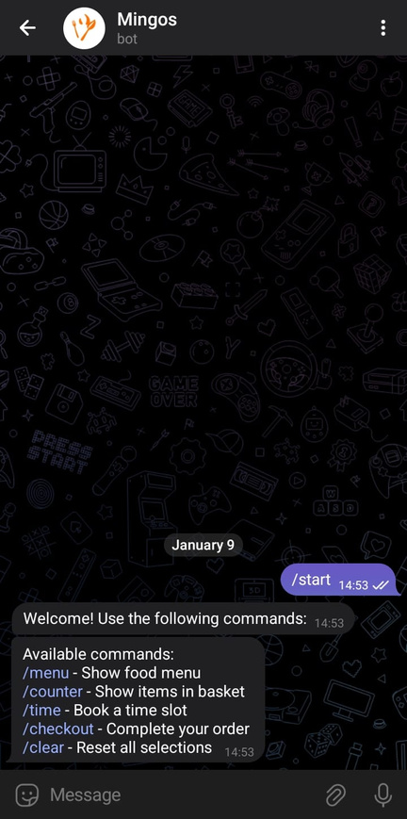
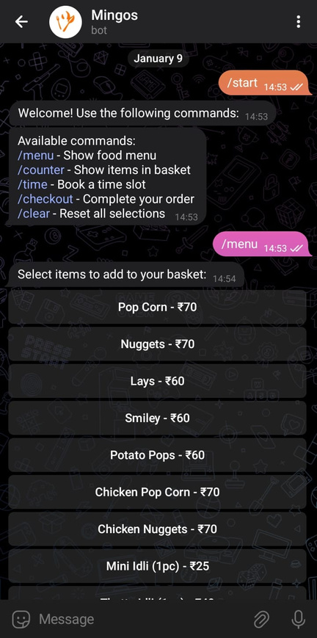
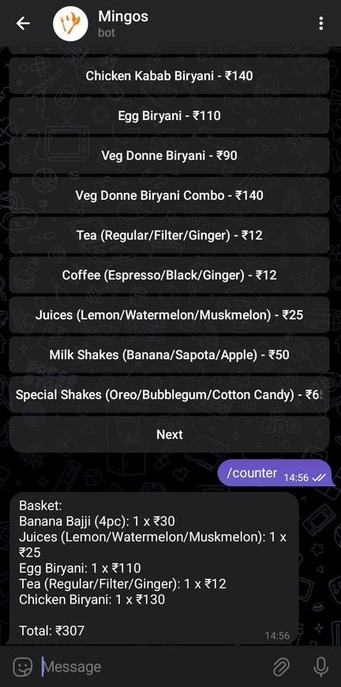
PROTOTYPE
SCREENSHOTS OF THE PROTOTYPE:
Department of Artificial Intelligence and Machine Learning

Slide 27
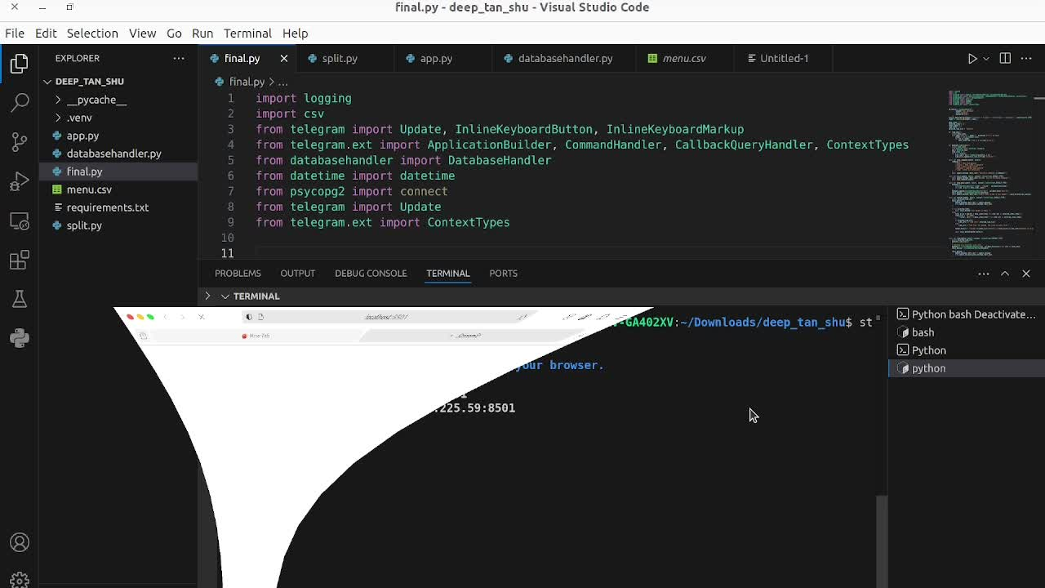
PROTOTYPE
Department of Artificial Intelligence and Machine Learning

Slide 28
COST
RV College of
Engineering
Telegram API:
Cost: ₹0 (Free to use).
Hosting (Server):
Shared Hosting: ₹350–₹500/month (e.g., Hostinger, Bluehost).
VPS Hosting: ₹400–₹800/month (e.g., DigitalOcean, Linode, AWS Lightsail basic plans).
AWS Free Tier: ₹0 (for the first 12 months, limited usage).
Google Cloud Free Tier: ₹0–₹700/month for micro instances.
Database:
Heroku (Basic Plan): ₹700–₹1,200/month.
AWS RDS (PostgreSQL/MySQL): ₹800–₹1,500/month.
Feature | Telegram Bot | WhatsApp Bot
API Cost | ₹0 | ₹0–₹3.50/message
Hosting (VPS) | ₹400–₹800 | ₹400–₹800
Database | ₹0–₹1,200 | ₹0–₹1,200
Total Monthly Cost | ₹400–₹2,000 | ₹400–₹3,500+
Department of Artificial Intelligence and Machine Learning
Notes:
<number>

Slide 29
SCALABILITY
RV College of
Engineering
1.Deploying to a Cloud Server: Using platforms like AWS EC2, Google Cloud, or Heroku to host bot. Setting up a continuous deployment pipeline (e.g., GitHub Actions, Docker) to ensure smooth updates.
2.Configure Webhooks: Set up Telegram webhooks to point to your server's endpoint, ensuring that your bot receives updates in real-time. Use SSL certificates (e.g., Let's Encrypt) for secure HTTPS communication.
3.Optimize for Scalability: Implement load balancing and use horizontal scaling to handle increased traffic. Integrate monitoring tools to track performance and uptime.
Department of Artificial Intelligence and Machine Learning
Notes:
<number>

Slide 30
RV College of
Engineering
INTEGRATING DATABASE
MANAGEMENT
Developing a backend system using a database like PostgreSQL or MongoDB, where chefs can update the stock in real-time through a simple interface, and the bot queries this database to check stock availability before confirming orders.
How it is useful?
Real-Time Updates: Users can see the availability of items in real-time, reducing the chances of ordering unavailable items.
Inventory Management: Chefs can easily track and manage inventory, ensuring that stock levels are accurate and up-to-date.
Improved User Experience: The system minimizes order cancellations due to stock issues, leading to better satisfaction for both users and staff.
Department of Artificial Intelligence and Machine Learning
Notes:
<number>

Slide 31
RV College of
Engineering
FUTURE SCOPE
UPI integration-
The app will integrate UPI payments for cashless transactions.
Users can make secure payments directly from their bank accounts.
Encrypted payment methods ensure the protection of user information.
Repayment-
if the chef cancels the order due to reasons like stock unavailable or if the user cancels due to genuine reasons the payment, should we refunded following a automated procedure and following up till user has received the amount
Stock notification-
Integrating a database base inventory mechanism will help the staff know about the number of items present and also display in the user interface so that user can know whether the item is available or out of stock before ordering.
Department of Artificial Intelligence and Machine Learning
Notes:
<number>

Slide 32
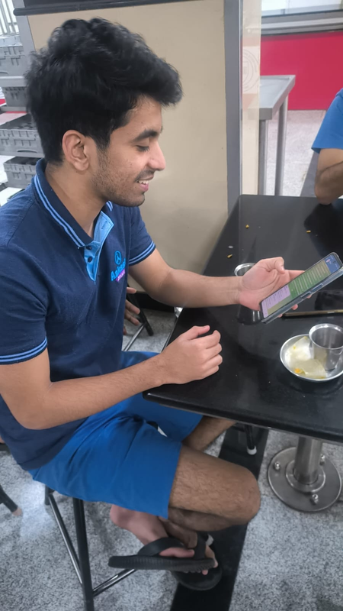
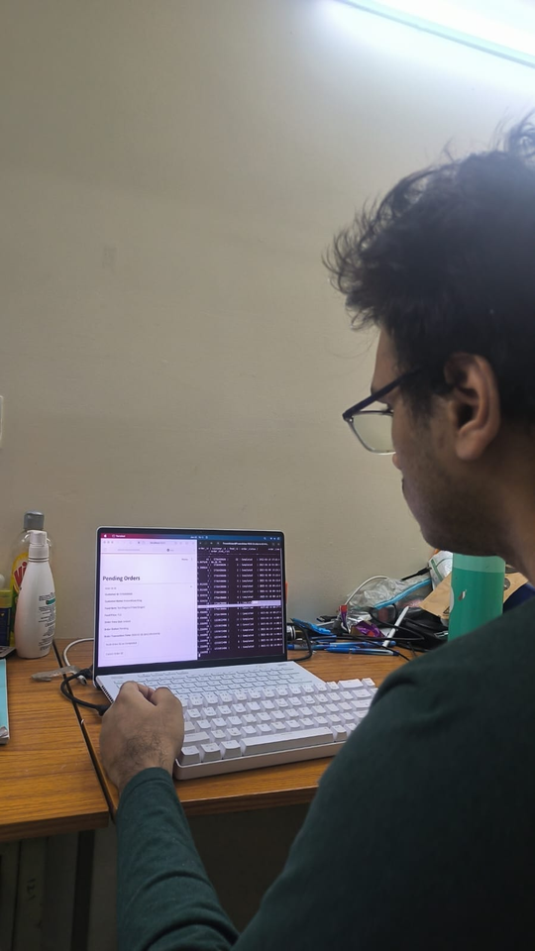
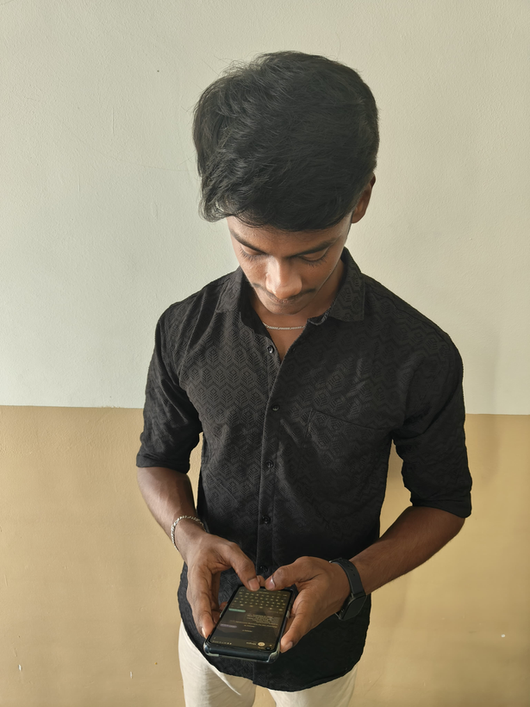
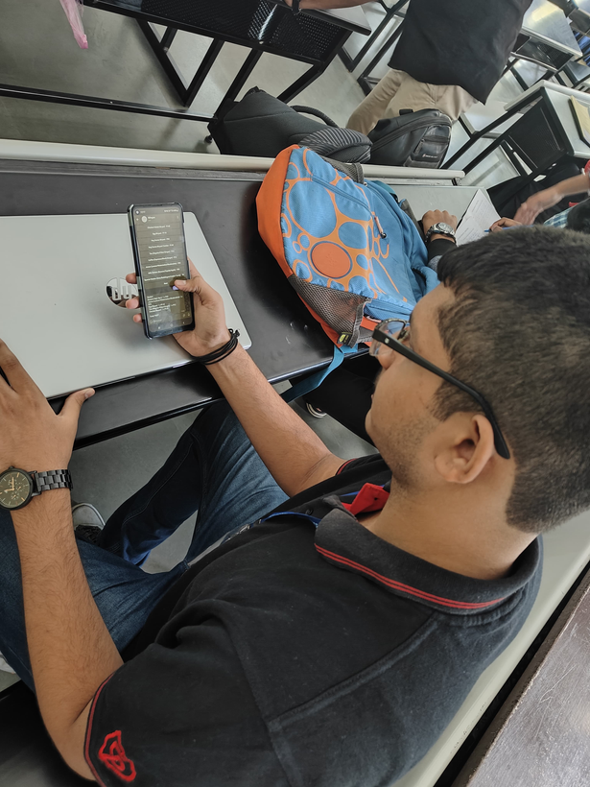
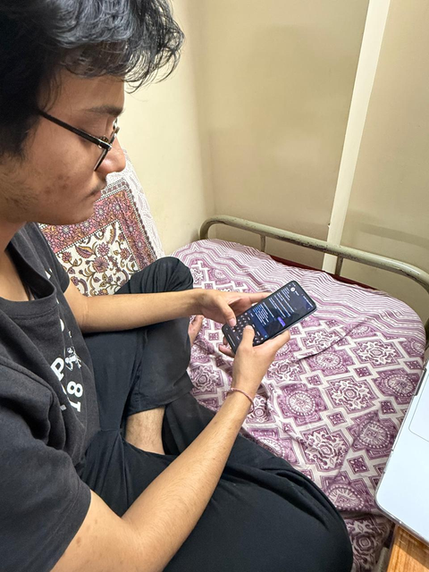
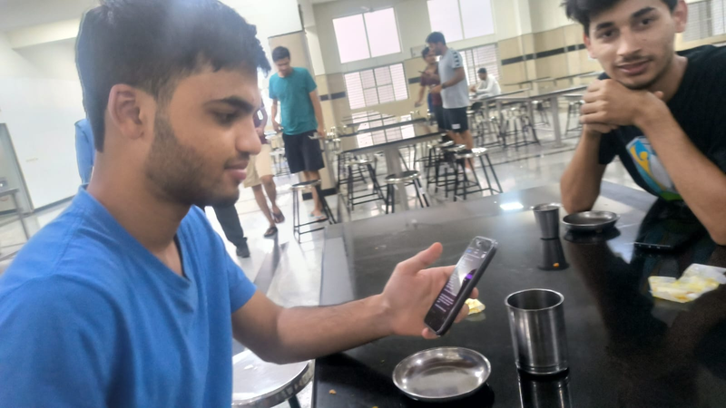
Testing Phase
RV College of
Engineering
User Testing
“Rough waiting timing can be showed on each time slot so that we can decide an optimised time slot based on our convenience”
“A notification could be provided when the order is ready”
Department of Artificial Intelligence and Machine Learning
Notes:
<number>

Slide 33
User Reviews
RV College of
Engineering
User have provided their feedback as follows
Multi Language Support -
This will remove language barriers and user can choose the preferred language and order seamlessly
Menu Customization-
this will enable users to select ingredients, cooking preferences ,dietary preferences, spice levels etc.
Display History -
if the users wants to order the same food he can just select it in the history rather than searching where the item is to place order.
Department of Artificial Intelligence and Machine Learning
Notes:
<number>

Slide 34
RV College of
Engineering
Positive feedback from users:
1.Reduced Wait Times:
2.Faster ordering
3.Improved Crowd Management:
4.Enhanced User Experience:
5.Efficient Canteen Operations:
Key Considerations from users
1.Operational Challenges (Managing Orders):
- Handling both app-based and walk-in orders can lead to confusion or delays if not managed properly.
2.Maintenance and Updates:
- Continuous maintenance, bug fixes, and updates are necessary to keep the app running smoothly.
Department of Artificial Intelligence and Machine Learning
Notes:
<number>

Slide 35
THANK YOU
Department of Artificial Intelligence and Machine Learning

